Slide 1
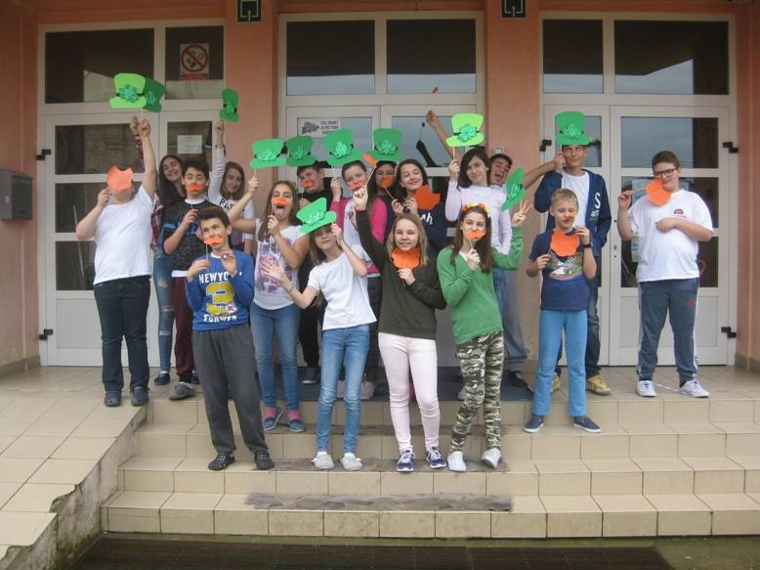
Saint Patrick’s Day Around the World

Slide 2
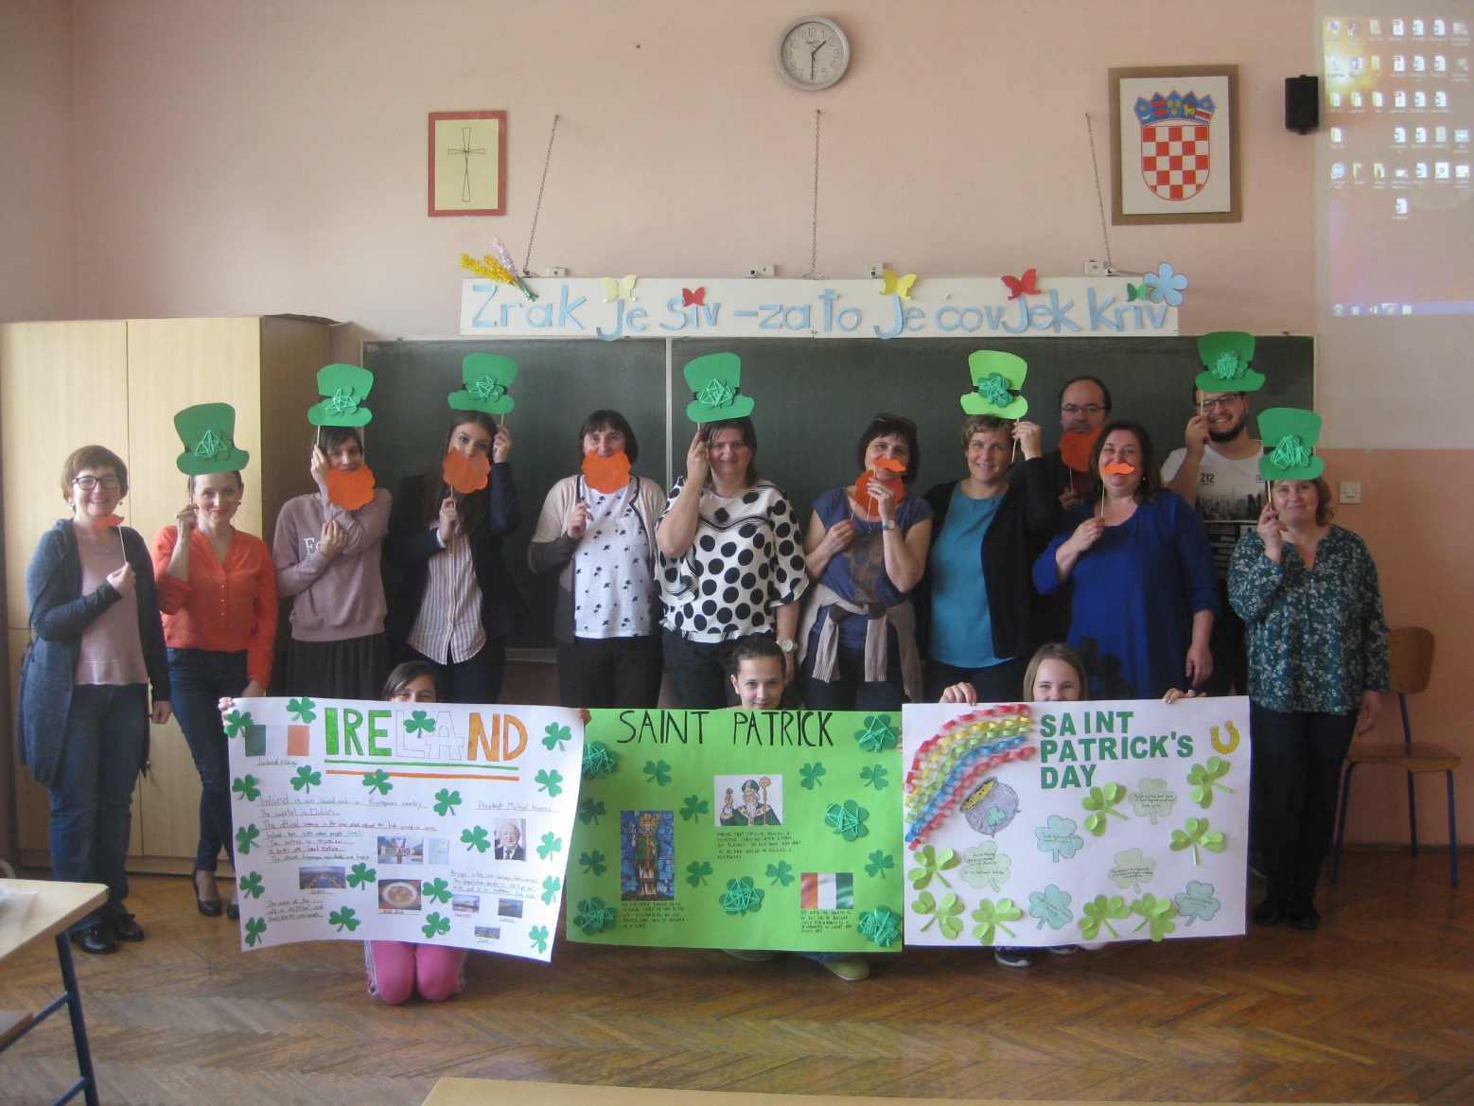

Slide 3
THE TABLE OF CONTENTS
Who are we?
Why did we decide to start this eTwinning project?
Who participated in the project?
What have Croatian teachers and pupils done?
What have the other members of the project done?
What have we concluded?

Slide 4
Who are we?
„Vladimir Nazor” Primary School is a small school in the village of Komletinci in the eastern part of Croatia. There are 118 pupils and our teachers (usually around 16 of them – the number is constantly changing) teach grades 1-8.
We are very proud that we have been an Eco-School for several years and our pupils’ cooperative UZ „Kockavica” is very popular due to the fact that pupils can improve their practical skills working on different assignments. Our pupils can choose from a variety of extracurricular activities and we participate in several charity events every year. At our school, we try to promote ecological awareness, healthy lifestyle, social competences, participation in numerous competitions and working on projects of all kinds. Why? Because school is not just a place where we talk about what a good life is – here we want to live that good life.
If you want to know more about our school please visit us at:
http://os-vnazor-komletinci.skole.hr/

Slide 6
Why did we decide to start this eTwinning project?
Since we heard many wonderful stories about how interesting it was for both teachers and pupils to work on such projects, we decide to create a story of our own.
We wanted to show our creativity through collaboration with teachers and pupils from other countries because it seemed like the best way of gaining knowledge and improving our skills. And this project gave us just that…

Slide 7
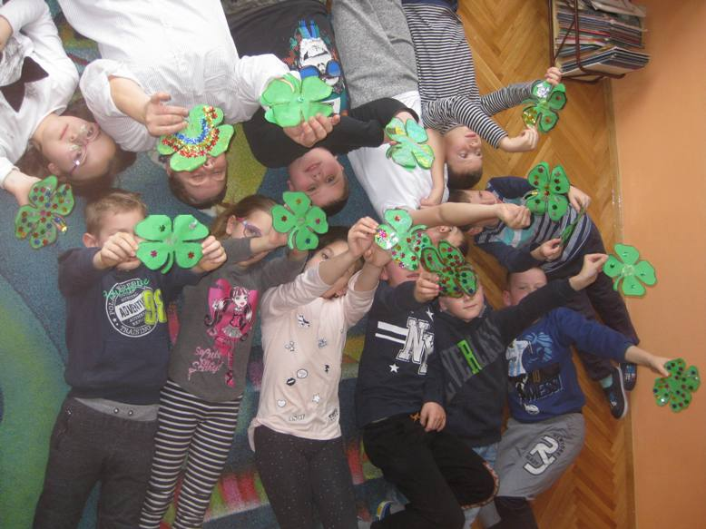

Slide 8
Who participated in the project?
After posting the idea for the project on eTwinning’s page, we soon found three schools whose teachers and pupils wanted to learn about Saint Patrick’s Day with us.
CEIP Reyes Católicos, Vera Spain
Zespół Szkół, Szkoła Podstawowa w Mstowie, Mstów Poland
ZŠ Jungmannova Litovel, Litovel Czech Republic

Slide 9
What have Croatian teachers and pupils done?
A lot… We really did.
Right from the start, it was obvious that we had so many ideas that were worth exploring and including in our work. We decided to find out information not only about Saint Patrick’s Day, but also about the saint behind this special day and the country where he lived.
While we were reading about Ireland and its numerous traditions, we decided to make ourselves at least a bit more … Irish. So we created props which helped us do just that.
Of course, we found many information about how the Irish like music and fun, so we listened to some Irish music as well and created Irish versions of „Noughts and Crosses”.

Slide 10
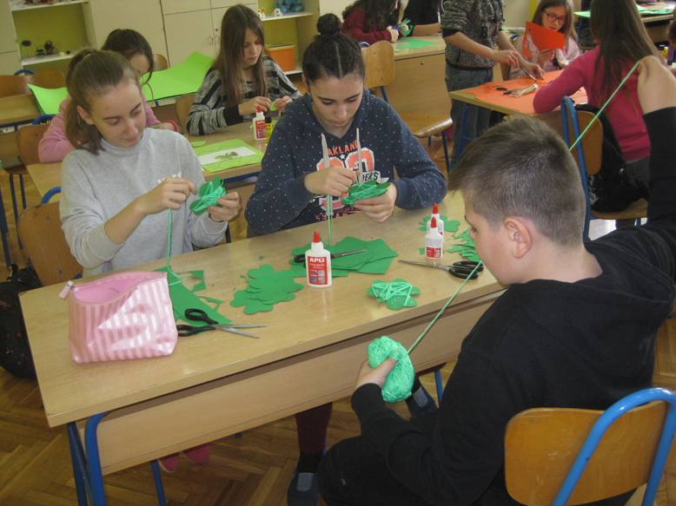
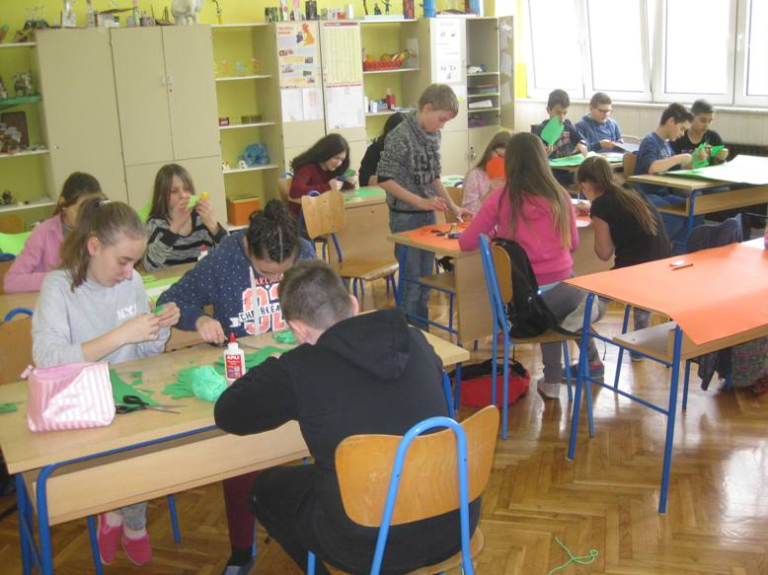

Slide 11
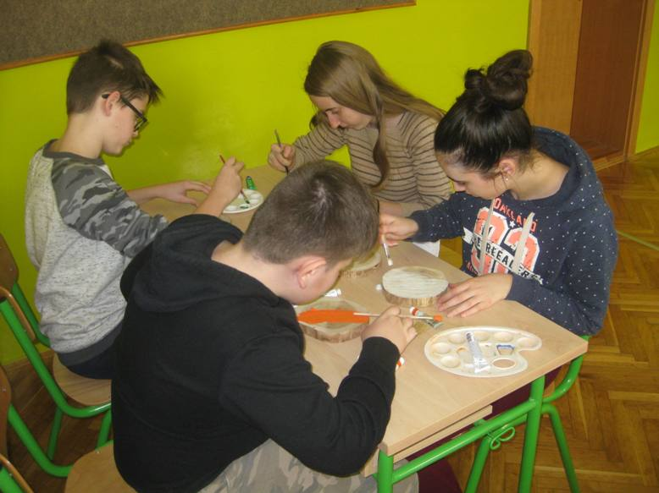
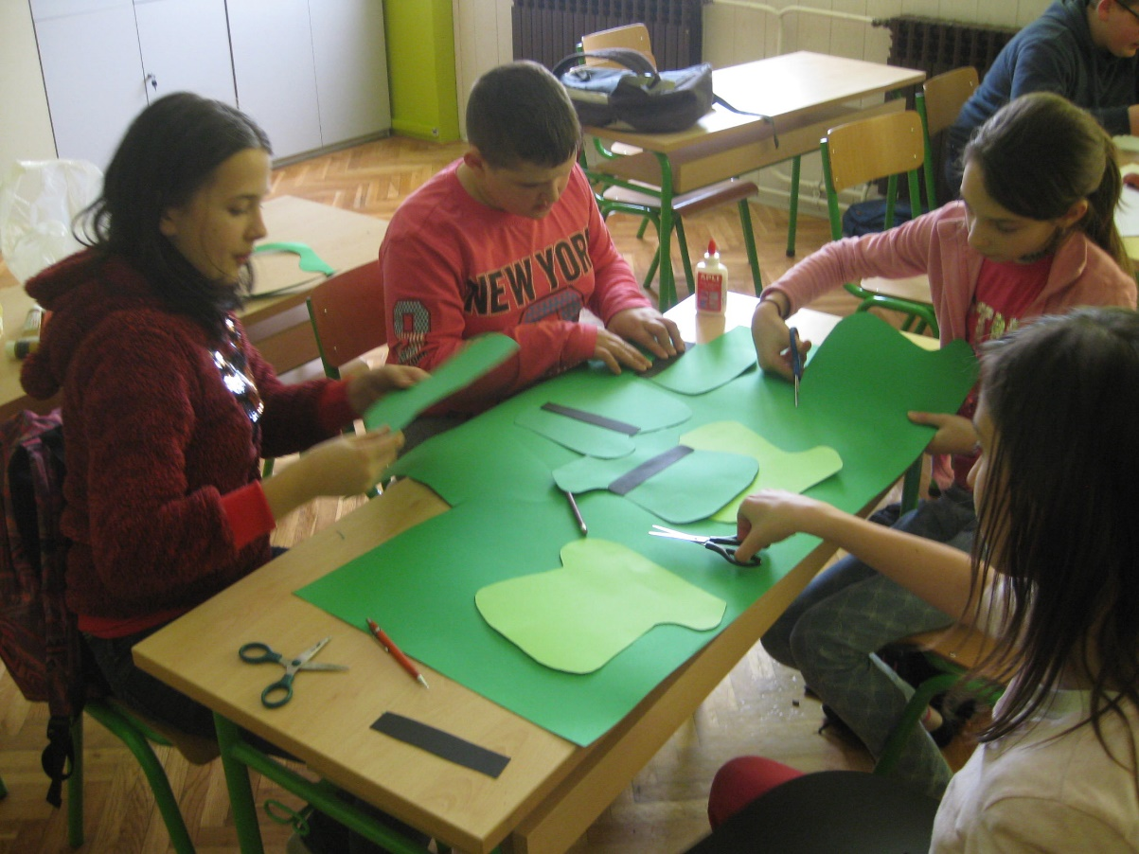

Slide 12
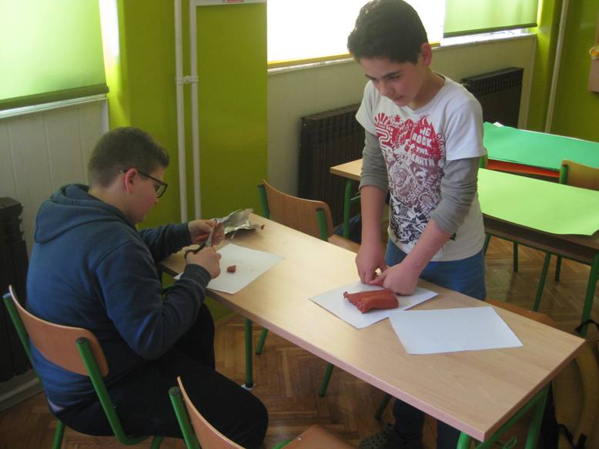
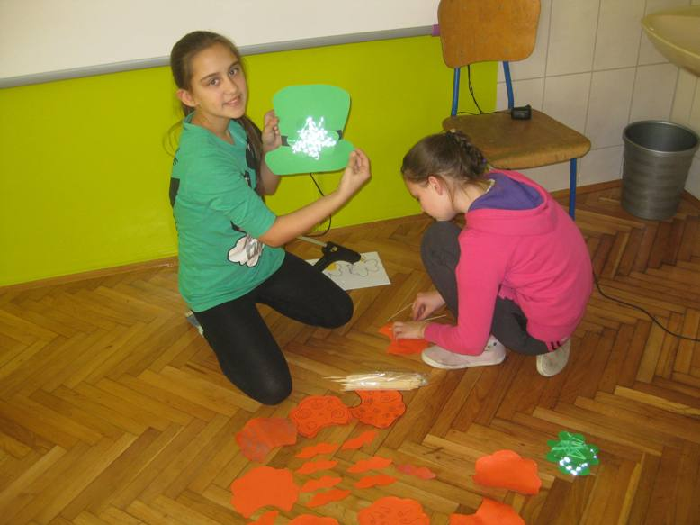

Slide 13
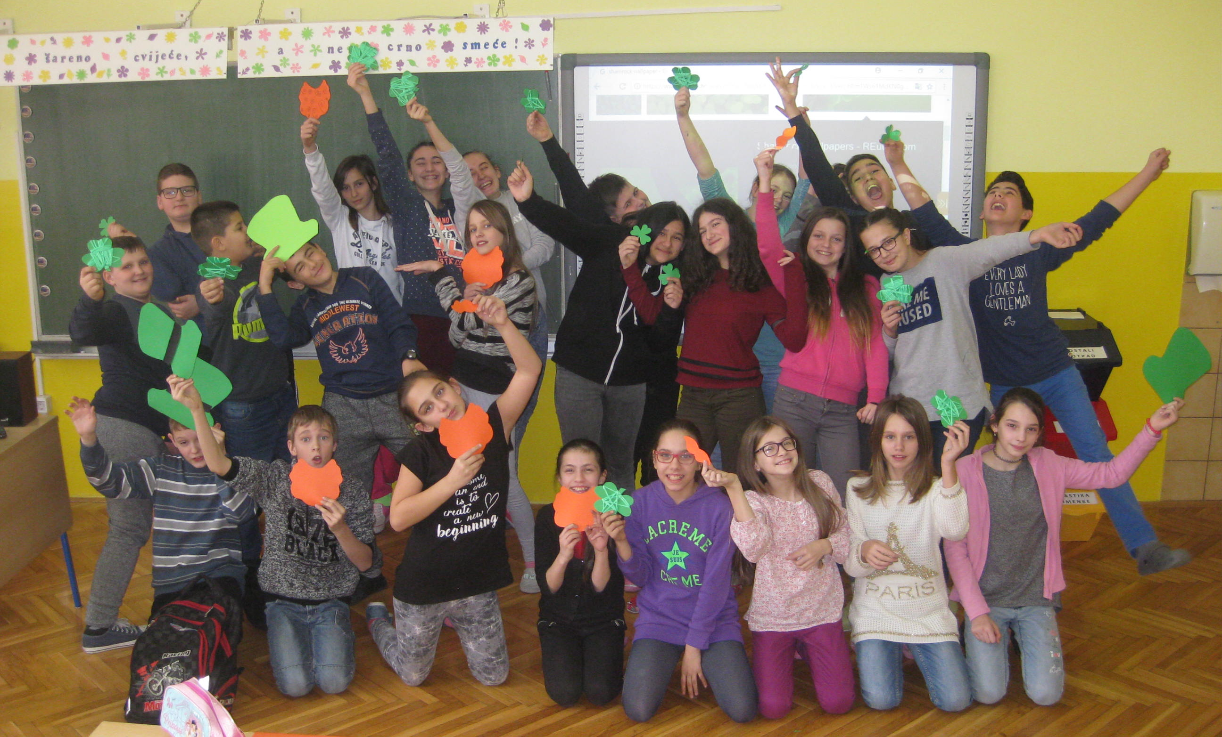

Slide 14
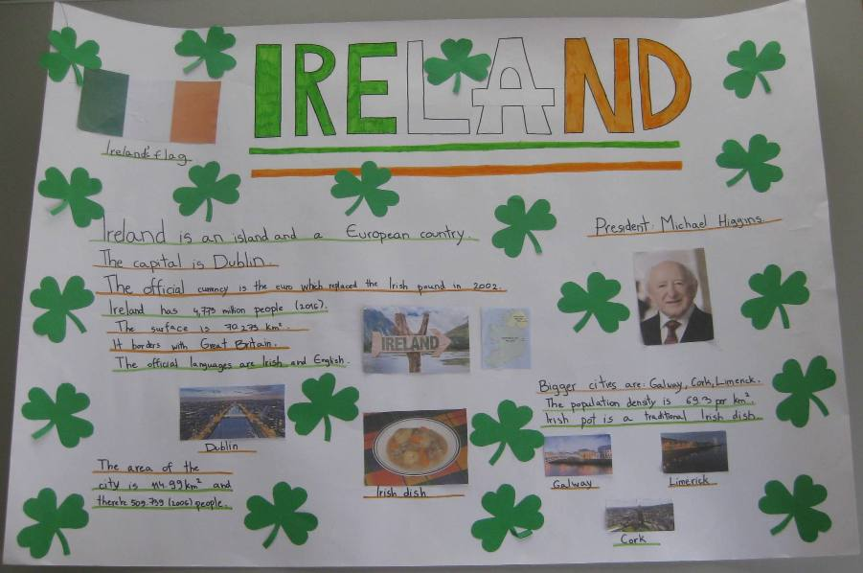

Slide 15
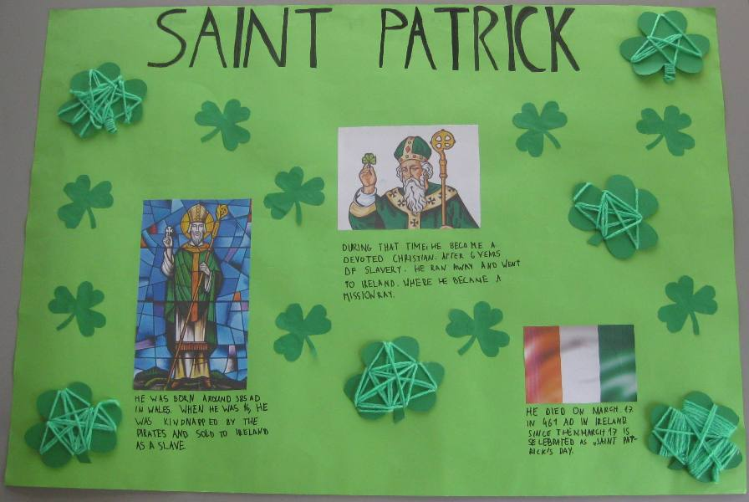

Slide 16
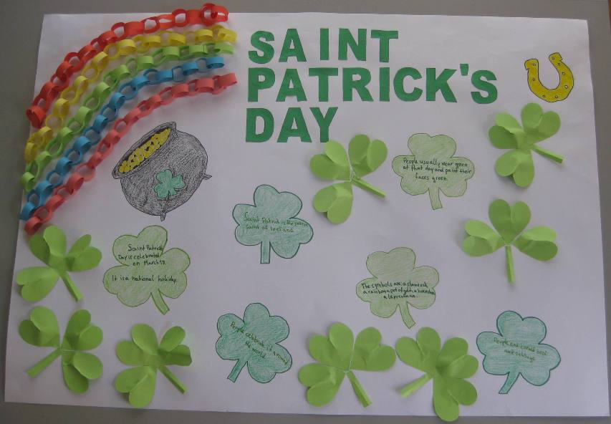

Slide 17
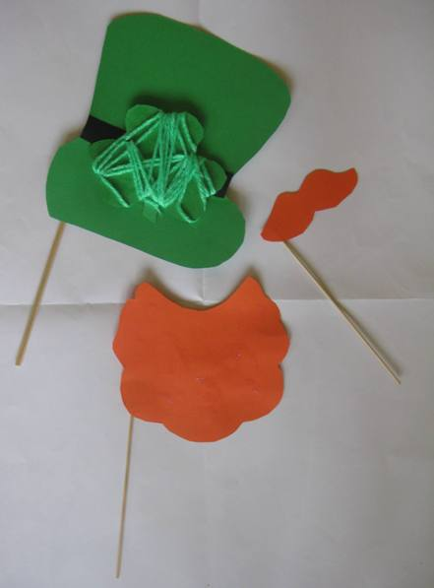
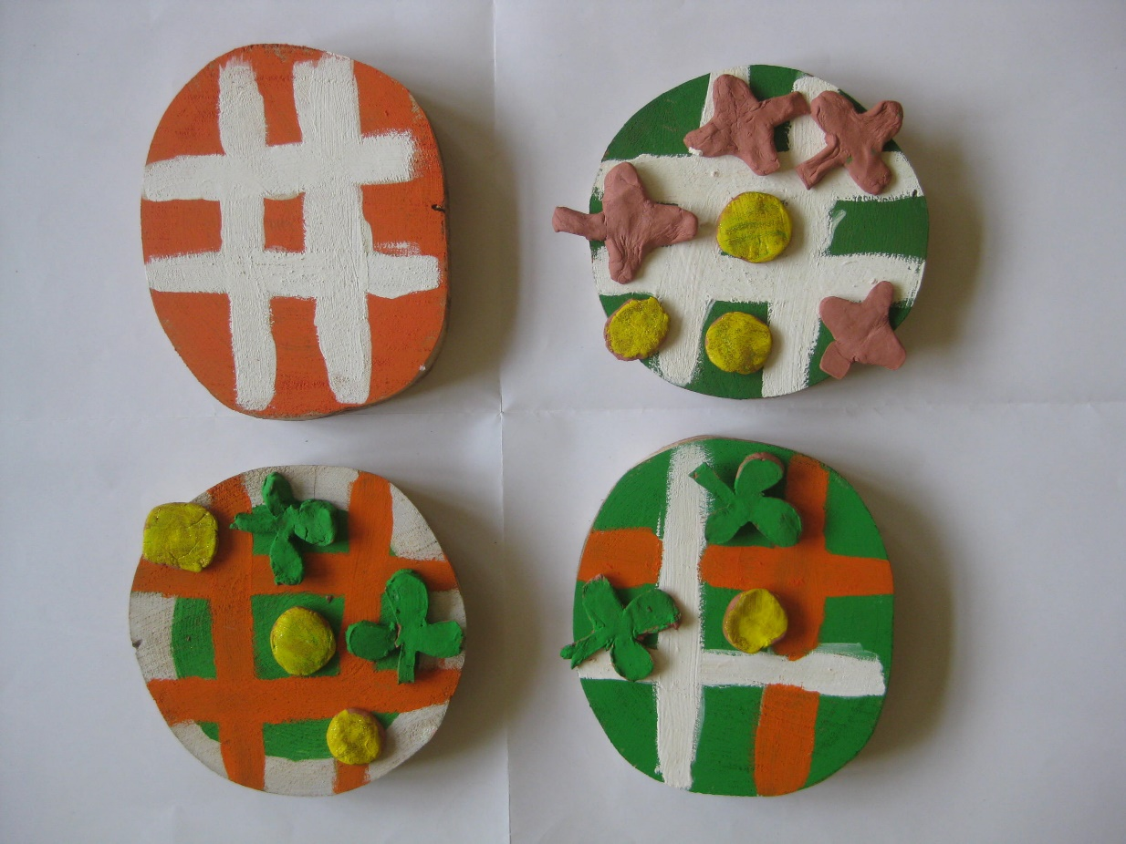

Slide 18
Around the time we finished planning and started working on our posters and props, the word got around our school about this new project because a lot of pupils were taking part and inviting others to join us. In the beginning, the pupils who worked on the project were from grades 5-7, but very soon other teachers and pupils began asking us about details of our project and wondering how they could participate, too.
Of course, we loved the idea and decided to assign our newest members some tasks… The first-graders and the second-graders started working on bookmarks and cards with their class teachers, and the members of our school’s cooperative had a great idea to produce wooden shamrocks which could later be sold to parents and other visitors.
And so our work continued…

Slide 19
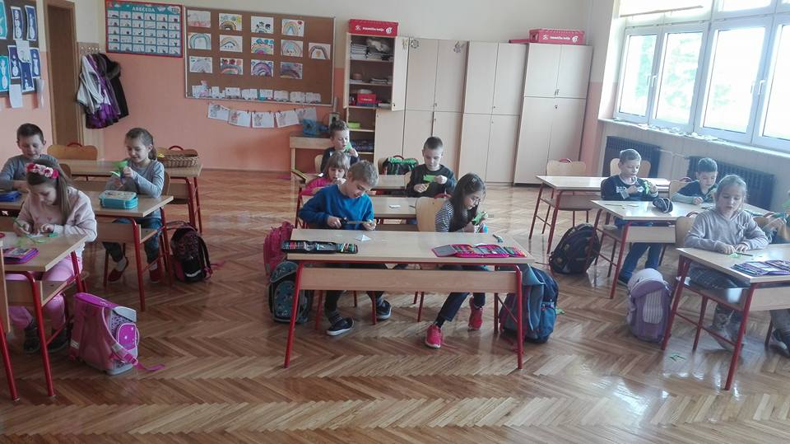

Slide 20
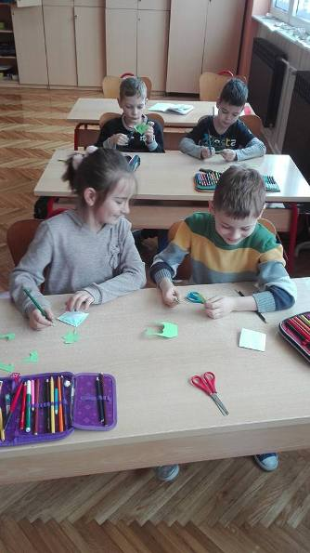
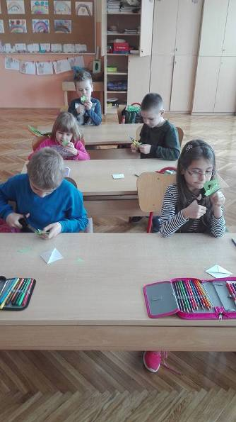

Slide 21
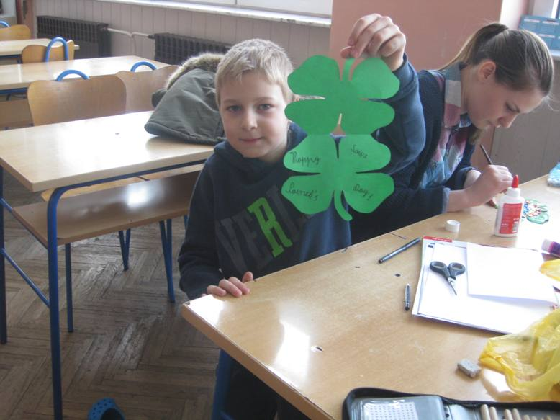
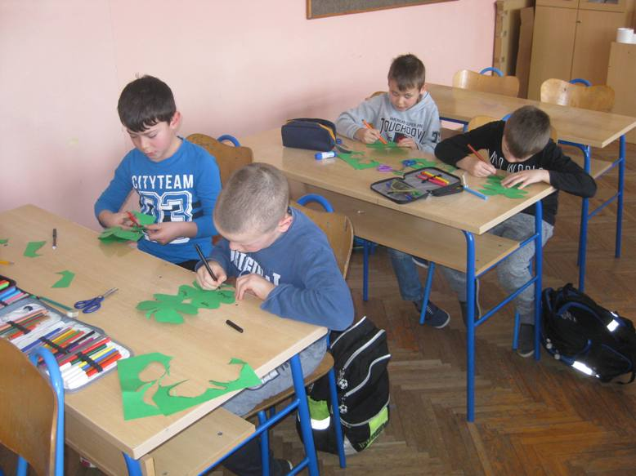

Slide 22
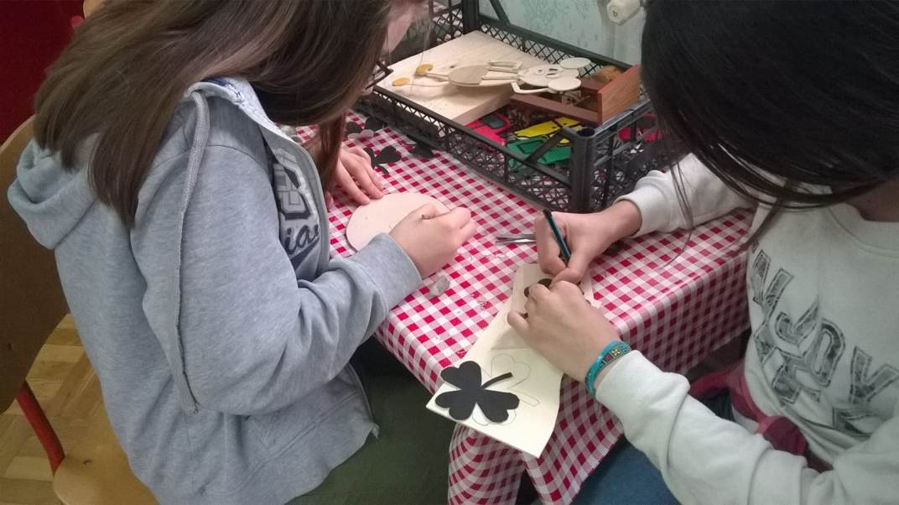

Slide 23
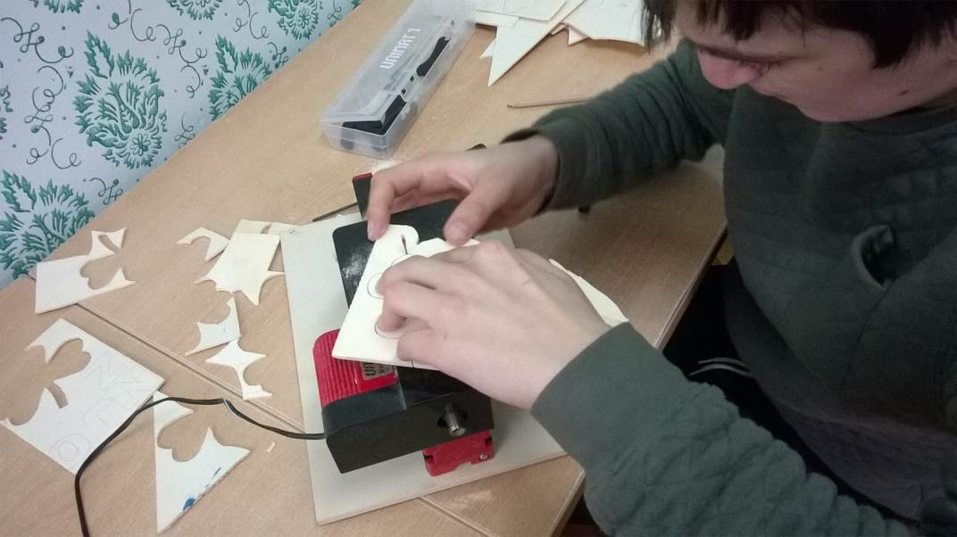

Slide 24
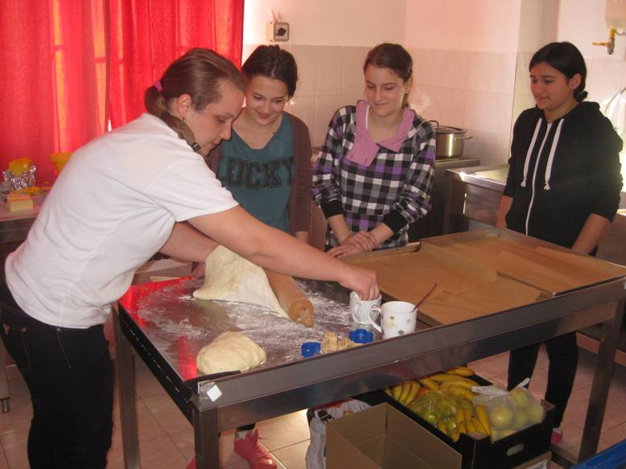
When our partners started posting pictures of their work, we got another idea…
Since they were preparing some healthy snacks, we decided to find a recipe for an easy but tasty Irish dish, and after a while we found a recipe for traditional salty Irish bagels. We decided to prepare the bagels and offer them during our presentation of the project. Our school’s cook offered us her help, so we were able to bake them the day before the presentation.

Slide 25
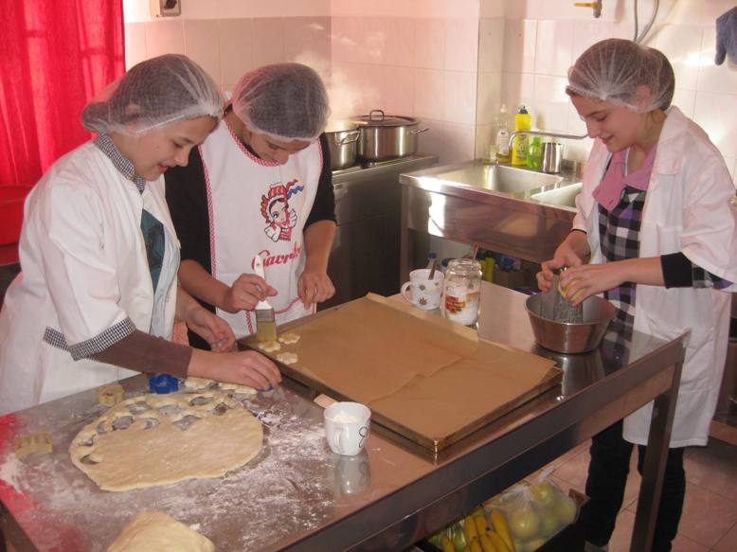

Slide 26
What have the other members of the project done?
Our partners proved to be very imaginative and skillful as well… Besides preparing healthy snacks and dishes, they also created posters, props, decorations, made and played instruments, created and watched presentations and did lots and lots more…
It was clear that the project was a great decision for all of us because were we learning and having fun at the same time, which was also our goal. At the same time, all of the members were posting diary entries, pictures and videos, so we were able to see how the project was developing at any time.

Slide 27
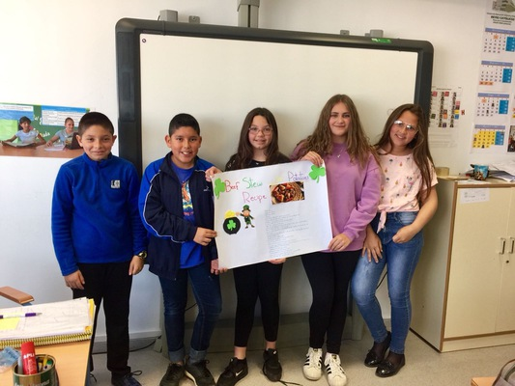
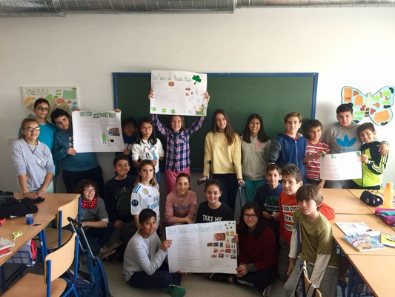

Slide 28
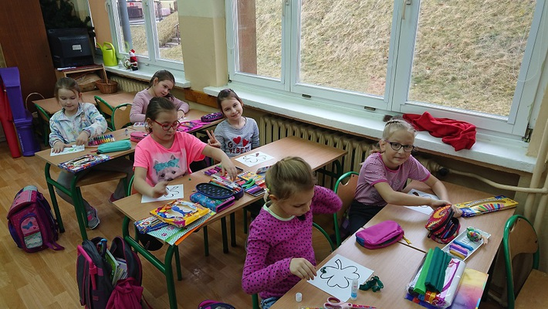
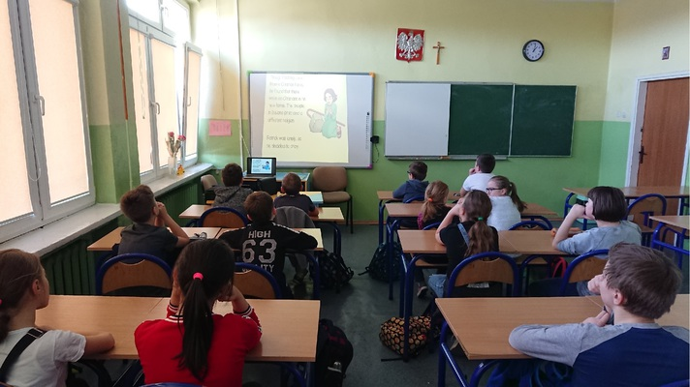

Slide 29
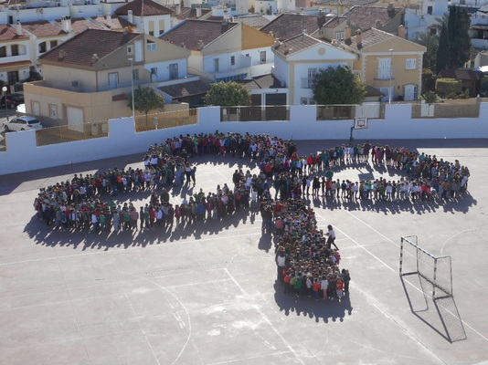

Slide 30
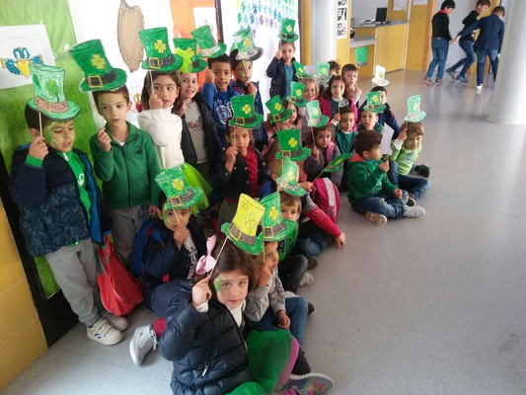
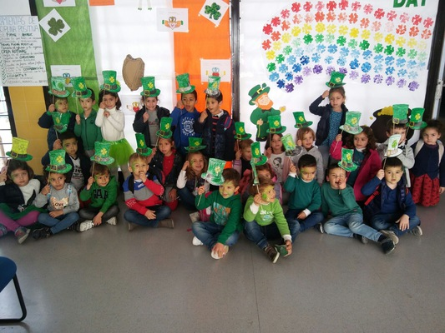

Slide 31
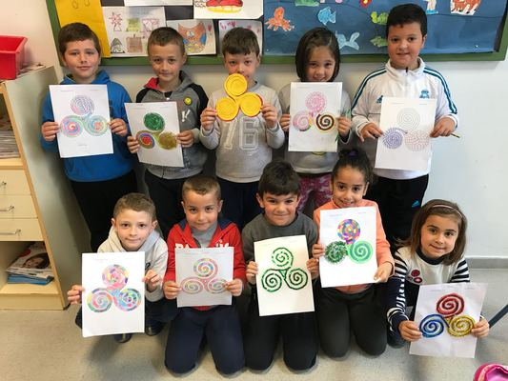
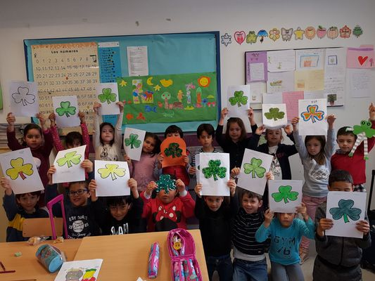

Slide 32
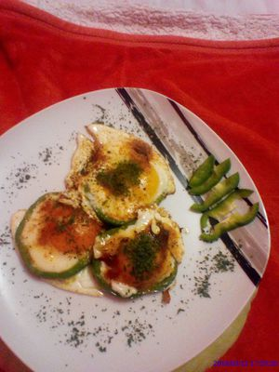
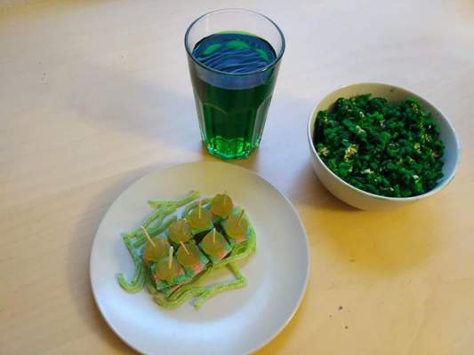

Slide 33
What have we concluded?
What all the teachers found most rewarding about this project was the enthusiasm and the effort which our pupils put into this project. They loved the topic, they had so many ideas on what we could do and how we could do it, and they were always ready to stay after their classes to finish drawing, colouring, cutting, pasting, watching, listening, baking, preparing… This proved that pupils could be easily motivated, that they had skills which were needed for accomplishing any goal and this is what teachers should have in mind at all times. If you need more proof of what you can achieve in a matter of weeks, here are some pictures from several presentations of the project in „Vladimir Nazor” Primary School in Komletinci (pupils to pupils, pupils to parents, pupils to teachers).

Slide 34
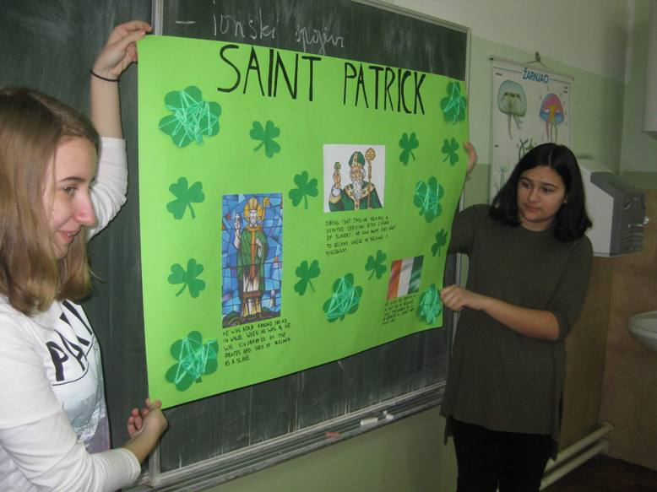
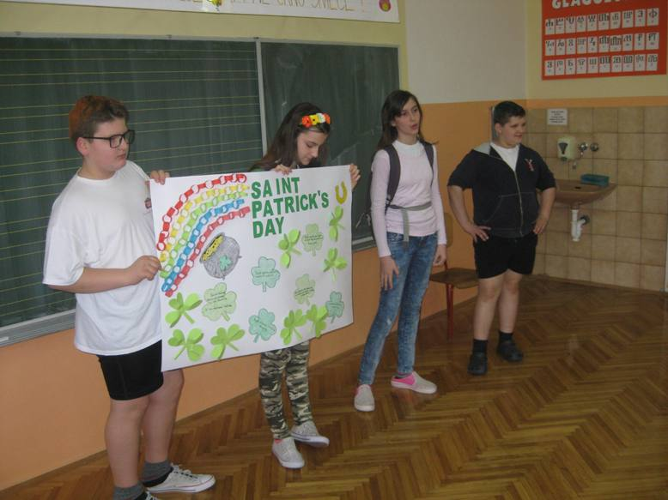
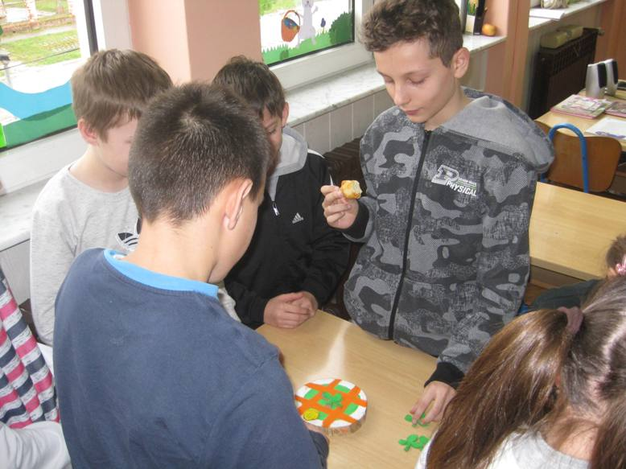
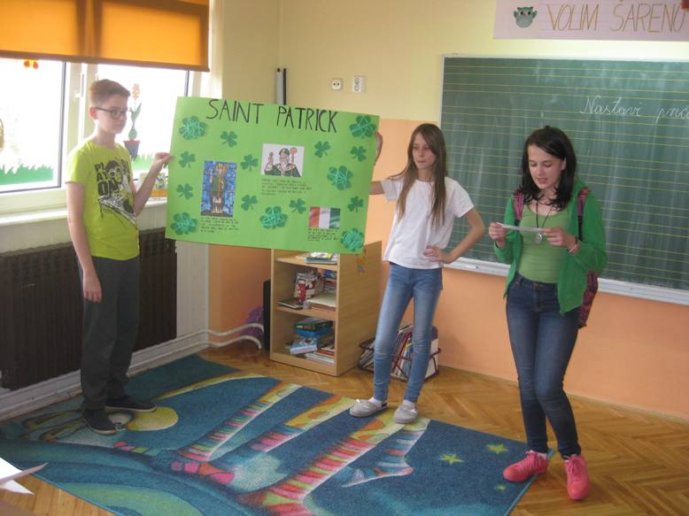

Slide 35
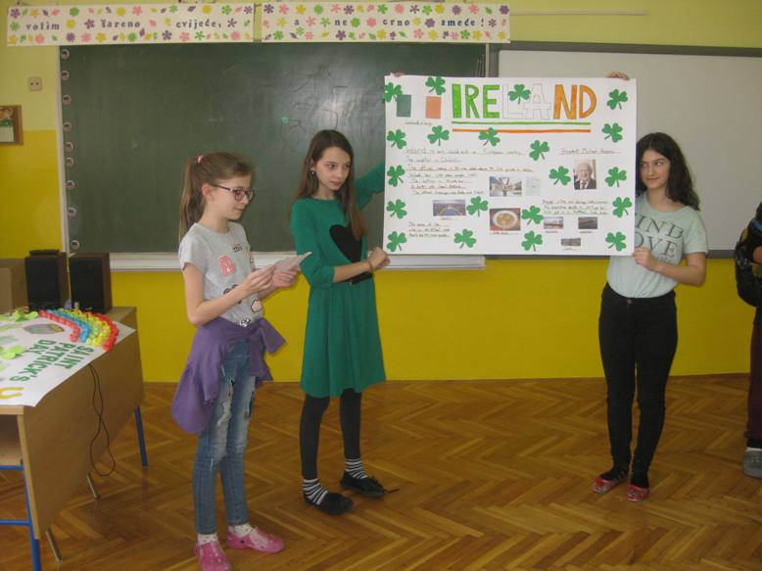
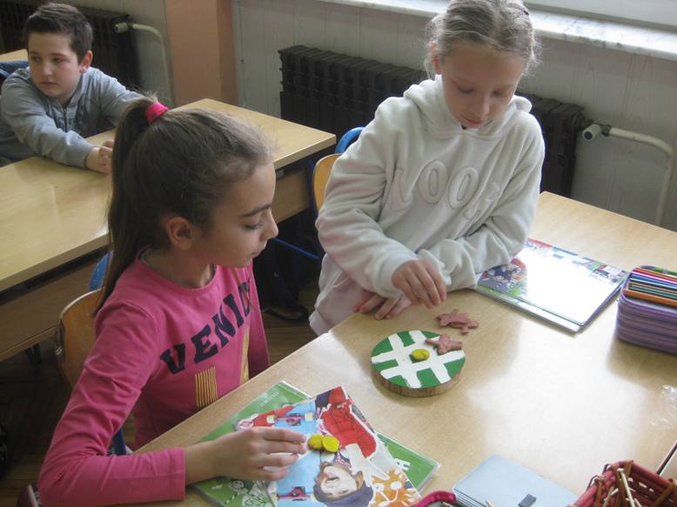
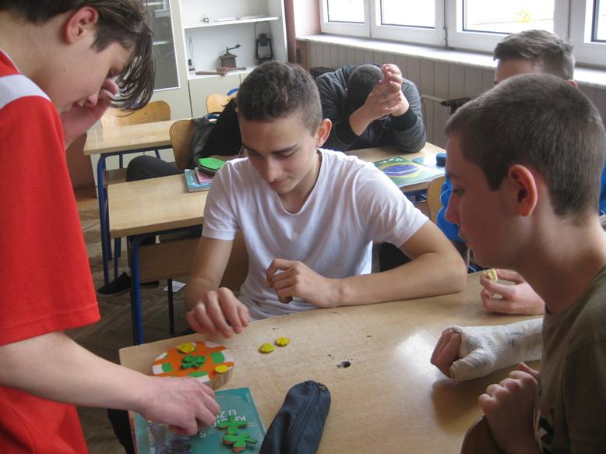
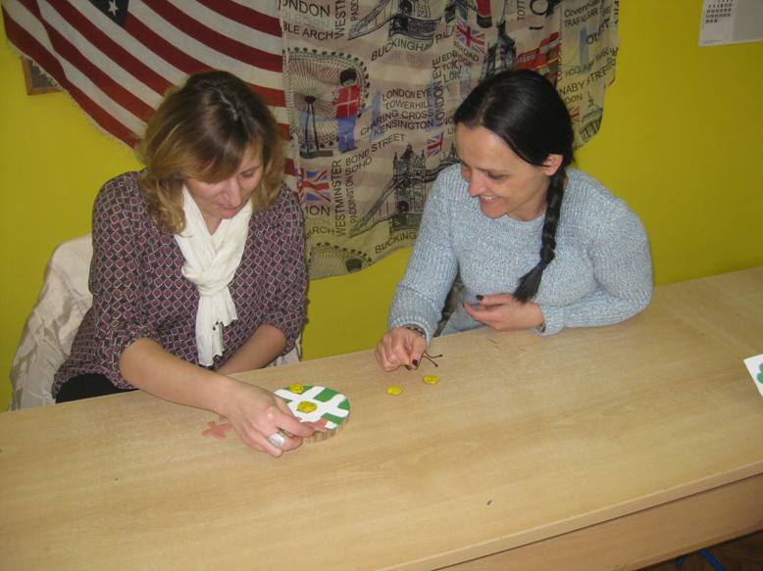

Slide 36
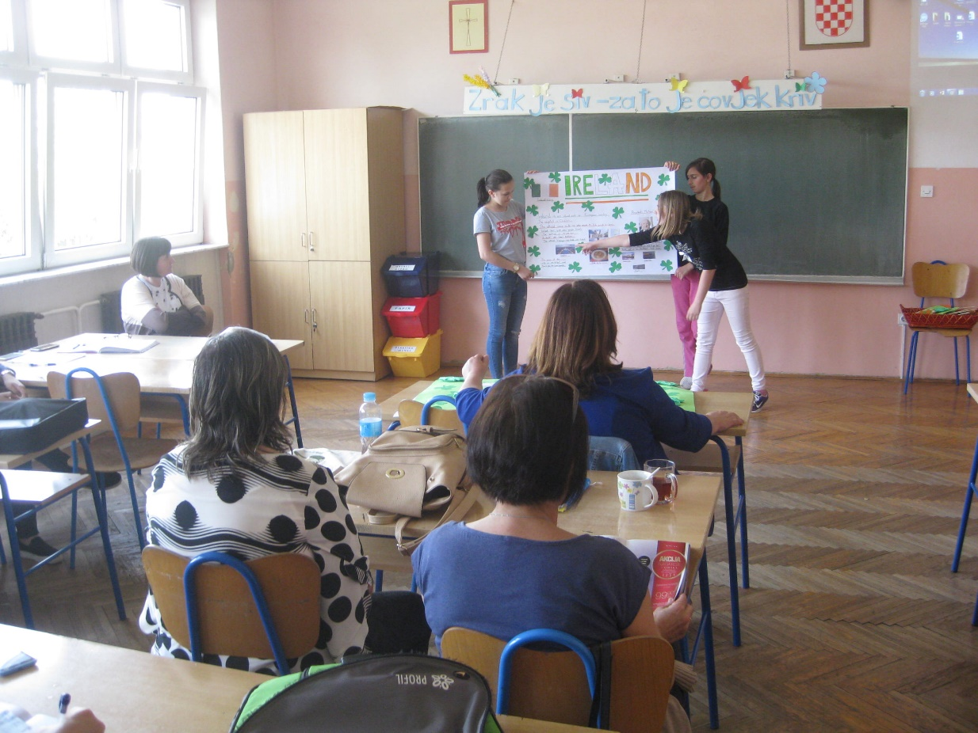
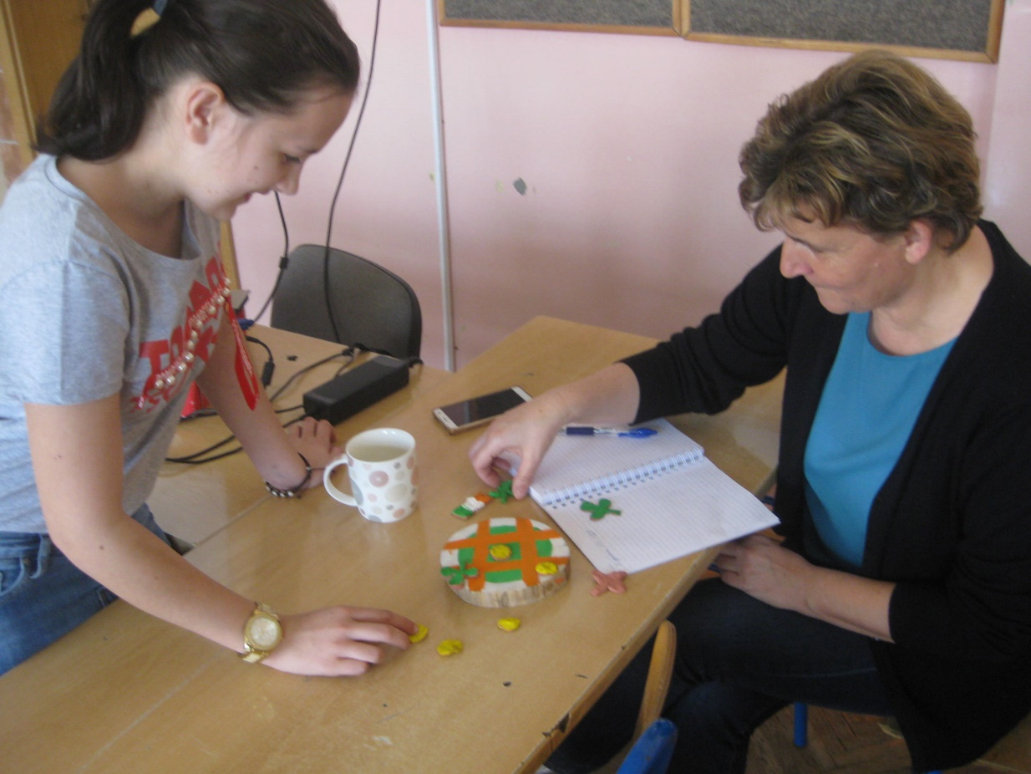

Slide 37
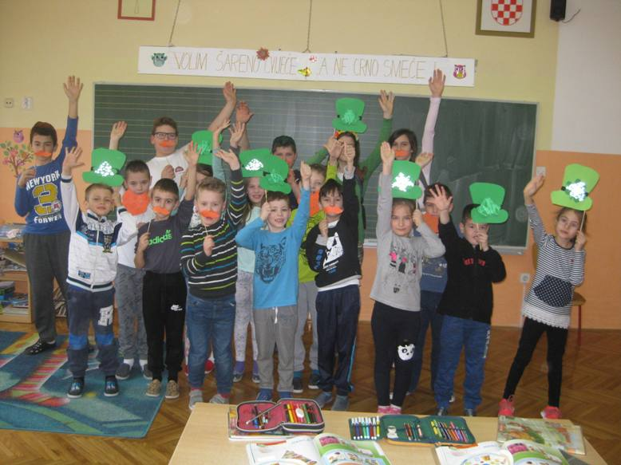
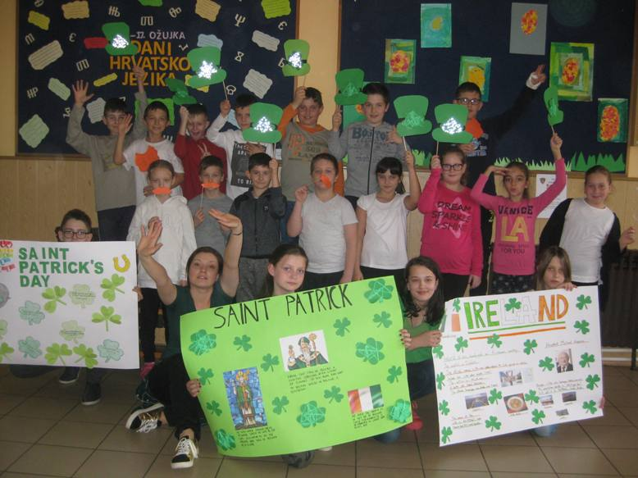

Slide 38
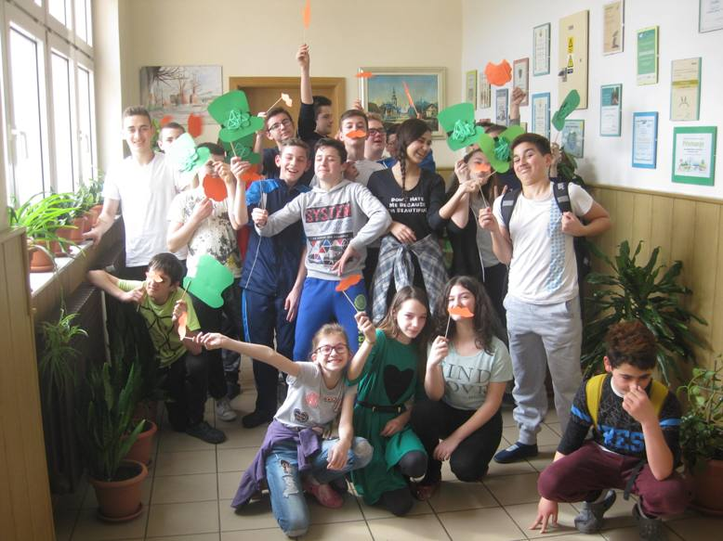
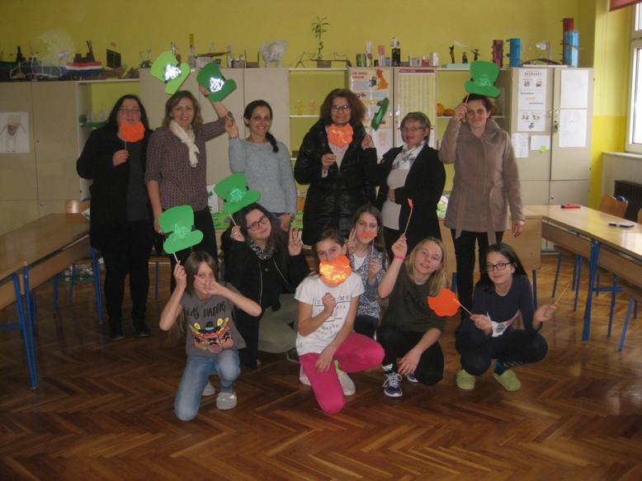

Slide 39
We hope that we have inspired you not only to explore Saint Patrick’s Day and other traditions of Ireland, but to consider taking part in similar projects because we guarantee a lot of fun and an exciting learning environment for everyone!

